Slide 1
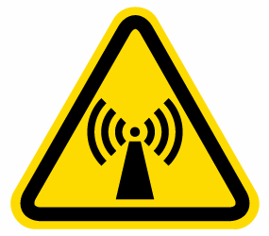
WARNING
RF/Microwave Radiation Hazard
Avoid Prolonged Exposure
Lab Safety Representative | Name | 054 – XXX – XXX
Lab Safety Representative (Alternate) | Name | 054 – XXX – XXX

