Slide 1
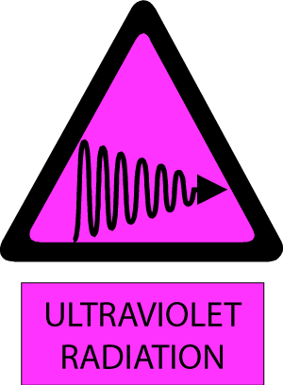
WARNING
Ultraviolet Light Hazard
Avoid Eye and Skin Exposure
Wear Proper Eye & Skin Protection
Lab Safety Representative | Name | 054 – XXX – XXX
Lab Safety Representative (Alternate) | Name | 054 – XXX – XXX

Slide 2
NOTICE
DO NOT USE
This UV Light is not in Service
Contact your LSR

